Slide 1

Website Traffic Forecasting
-RAJU MATAM

Slide 2
AGENDA
OBECTIVE
Developing a robust forecasting model for daily website traffic
Importance of accurate traffic prediction for business growth
Data Collection & Preprocessing
Data sources and key features used (Page Loads, Unique Visits, etc.)
Handling missing values, outliers, and data transformation
Exploratory Data Analysis (EDA)
Identifying trends, seasonality, and anomalies in traffic data
Visualizing historical patterns and correlations
Forecasting Approaches
Machine Learning Models: Random Forest, Decision Tree and etc
Hybrid Models: Combining multiple techniques for better accuracy
Model Evaluation & Validation
Performance metrics: RMSE, MAPE, R² Score
Cross-validation techniques for reliable results

Slide 3
Key Metrics and Factors
Day: Specific day of the analysis period.
Day of the Week: Day name (e.g., Monday, Tuesday) to identify weekly trends.
Date: Exact date of the recorded data.
Page Loads: Total number of pages loaded by visitors.
Unique Visits: Count of distinct individuals visiting the site.
First-Time Visits: Number of visitors accessing the site for the first time.
Returning Visits: Number of repeat visitors to the site.
Year: Year of the recorded data for annual trend analysis.

Slide 4
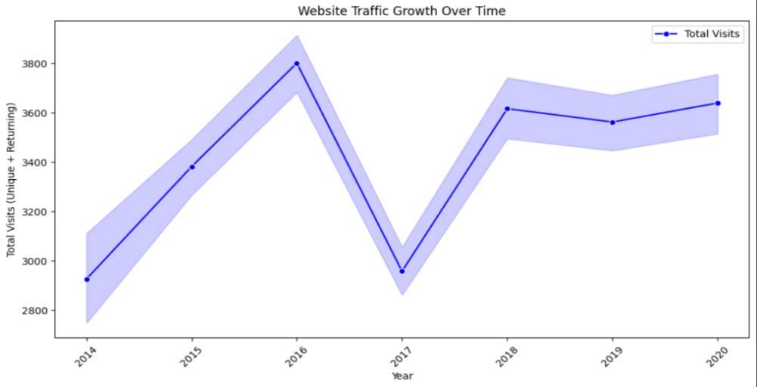
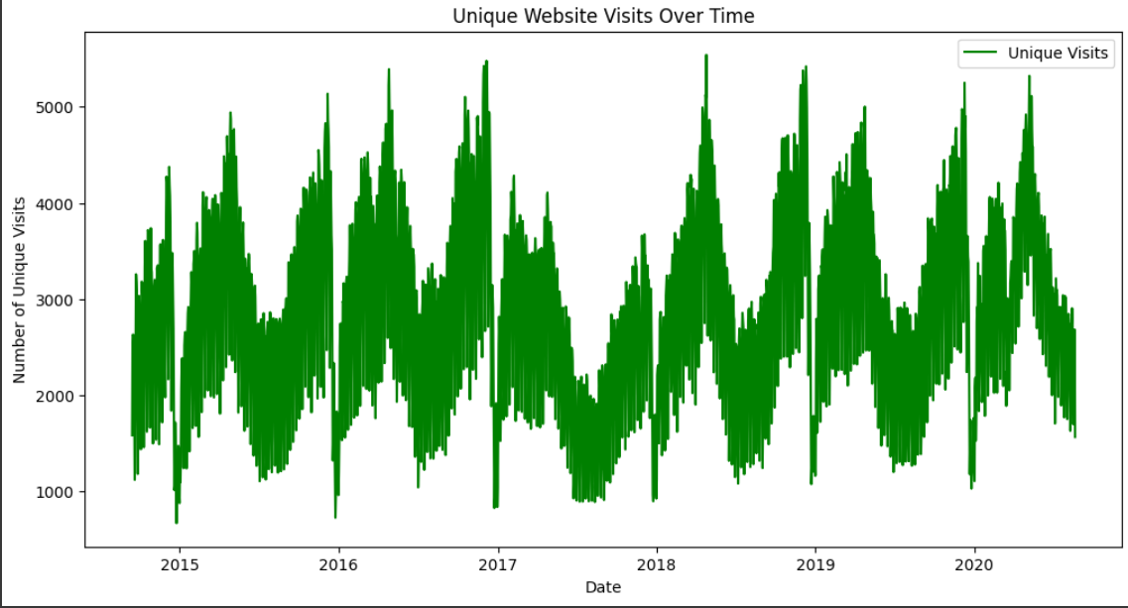
EXPLORATORY DATA ANALYSIS
Significant Growth: Total visits to the website have increased from 1,000 to 3,000 over the years, indicating a 3x growth in traffic.
Positive Trend: The upward trajectory reflects increased user engagement or expanded reach of the website.
Annual Tracking: The data is tracked by year, showcasing consistent growth and providing a clear timeline for performance analysis.
Trend Analysis: The graph tracks the number of unique visits to the website from 2015 to 2017, providing insights into user growth over time.
Performance Over Years: By analyzing the data annually, it helps identify growth patterns, peak periods, or potential declines in unique traffic.

Slide 5
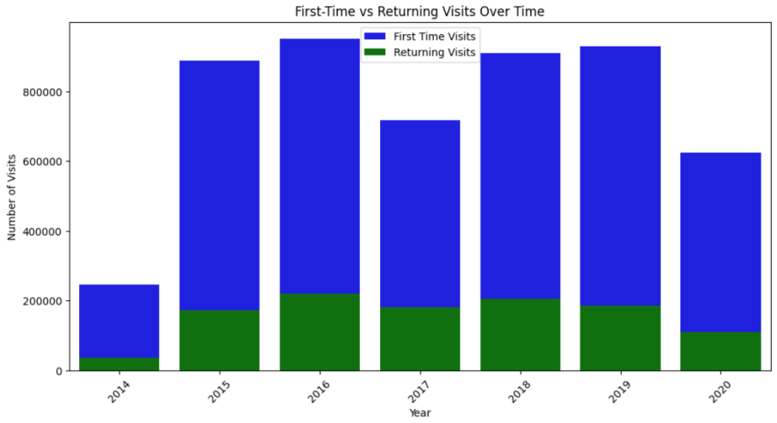
Above bar plot compare the First time visitor and Returning visitor over the time
First-time visits consistently outnumber returning visits, indicating a strong reliance on new user acquisition.
First-time visits fluctuated more significantly over the years compared to the relatively stable trend of returning visits.
Both first-time and returning visits appear to have decreased in 2020, suggesting a potential impact from external factors or changes in strategy.

Slide 6
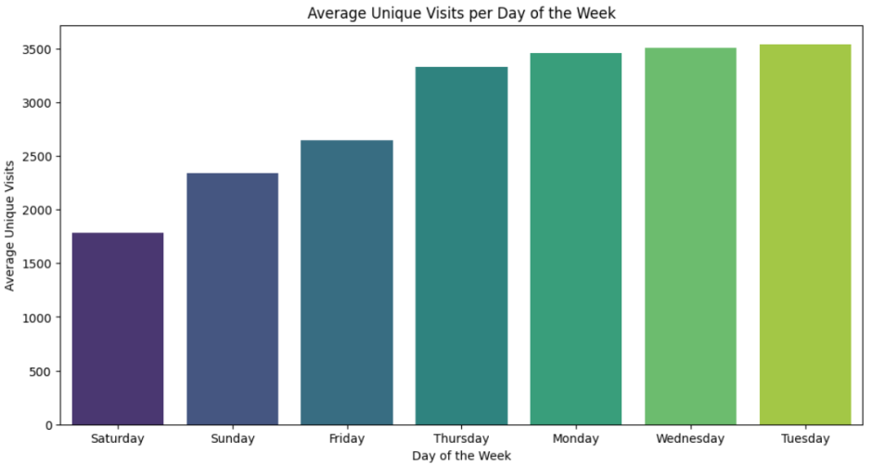
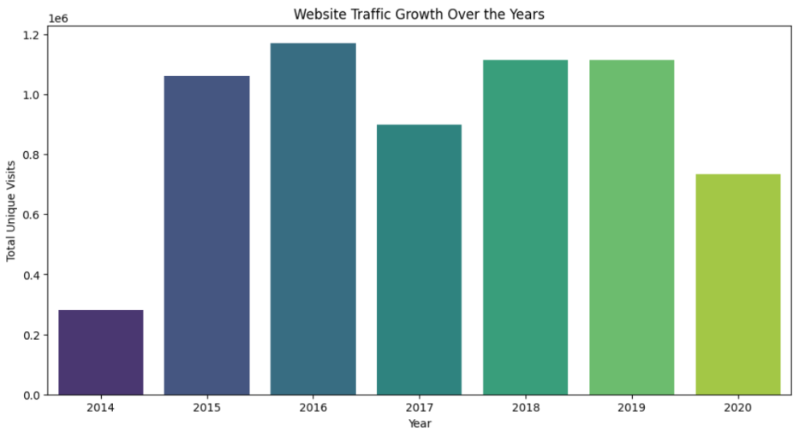
Website traffic peaks on Wednesday and is lowest on Saturday.
There's a clear trend of increasing traffic from Sunday through Wednesday.
The data suggests a strong weekday bias in website usage.
This could involve running special weekend promotions, scheduling engaging social media posts, or offering exclusive content to weekend visitors.
The chart clearly illustrates a period of significant growth in website traffic from 2014 to 2016.
After the rapid growth phase, the website traffic appears to plateau from 2016 to 2019, with minimal change. Then, in 2020, there is a sharp decline in unique visits.
Possible factors to consider include changes in search engine algorithms, shifts in user behavior, technical issues with the website, or changes in marketing strategies.

Slide 7
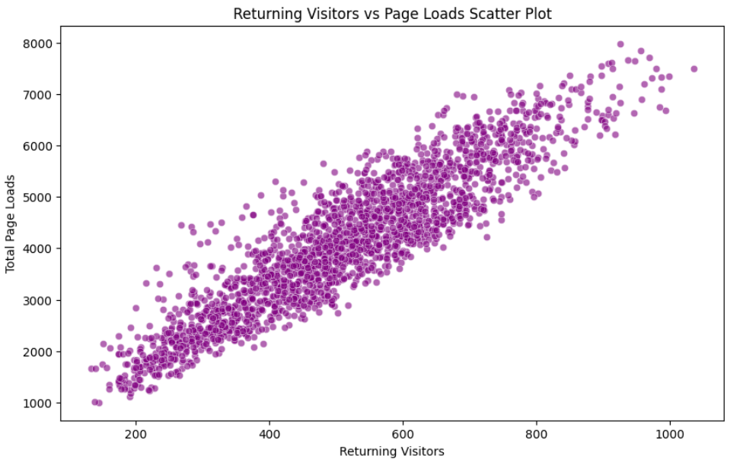
Strong Positive Correlation: The upward trend of the data points indicates a strong positive relationship between returning visitors and page loads. This suggests that returning visitors are a significant driver of page views. The more returning visitors a website has, the more page loads it is likely to experience.
Engagement of Returning Visitors: The fact that page loads increase with returning visitors suggests that these visitors are engaging with the website more deeply, browsing multiple pages during their sessions. This highlights the importance of retaining visitors, as they contribute significantly to website traffic and engagement.

Slide 8
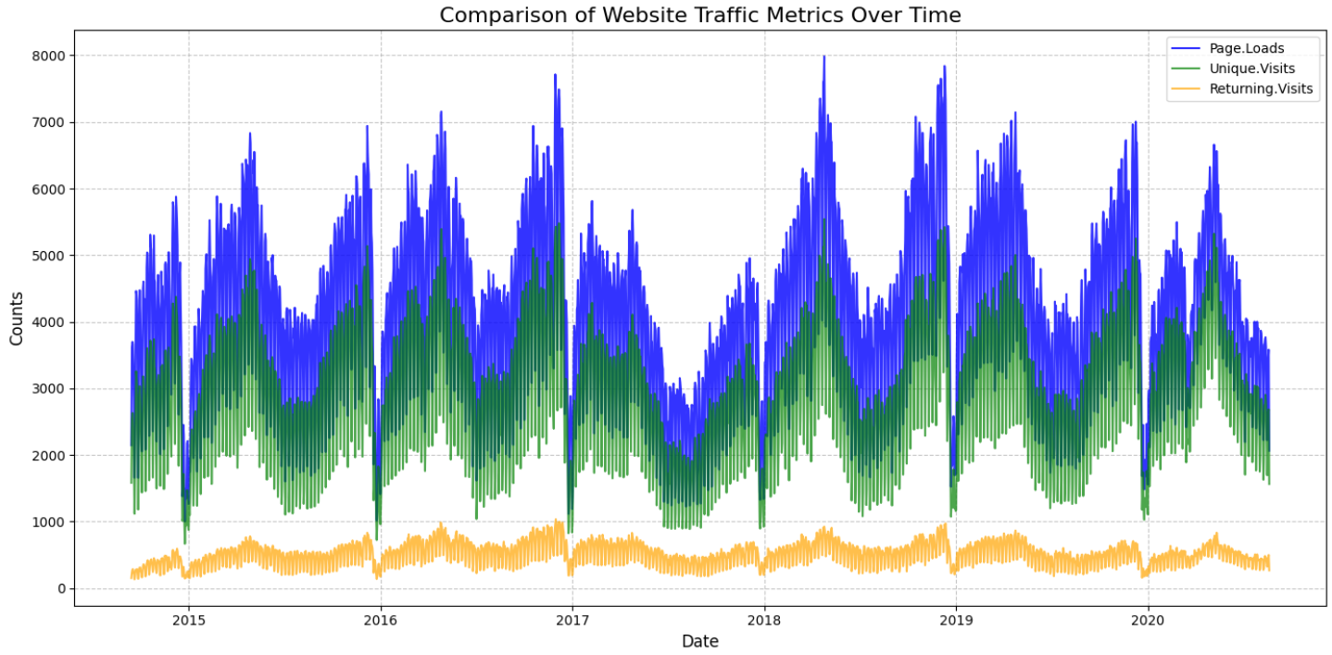
Page Loads and Unique Visits Follow Similar Patterns: The blue (Page Loads) and green (Unique Visits) lines closely mirror each other, showing similar peaks and valleys throughout the time period. This indicates a strong correlation – as expected, more unique visits generally lead to more page loads. The magnitude of page loads is consistently higher than unique visits
Returning Visits are Significantly Lower but More Stable: The orange (Returning Visits) line sits at the bottom of the chart, showing a much lower count compared to the other two metrics. This suggests a consistent base of returning users who regularly engage with the website.
Potential for Deeper Dive into Fluctuations: The chart shows noticeable fluctuations in all three metrics, especially for page loads and unique visits. These fluctuations could be due to various factors, such as:
Seasonality: Website traffic might fluctuate with seasons or specific times of the year.
Marketing Campaigns: Marketing efforts can drive temporary spikes in traffic.

Slide 9
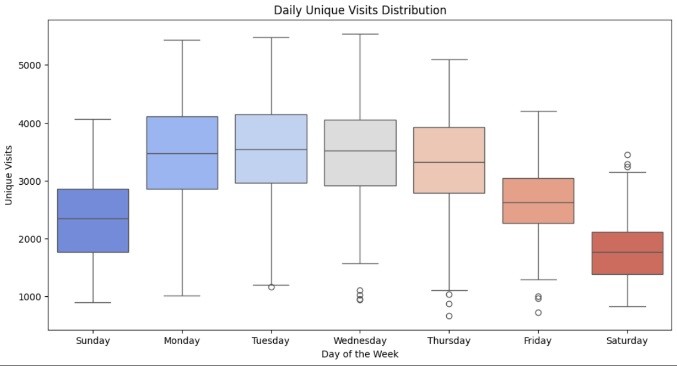
Weekend vs. Weekday Traffic: The most striking observation is the clear difference in unique visits between weekends (Saturday and Sunday) and weekdays. Weekends have significantly lower median unique visits (the line inside the box) and a smaller overall range (box height). Weekdays, from Monday to Friday, show higher median visits and greater variability.
Wednesday Peak: While weekdays are generally higher, Wednesday stands out with the highest median unique visits. This suggests Wednesday might be a peak day for website activity.
Variability and Outliers: The box plots reveal the variability in unique visits for each day. Some days, like Thursday and Saturday, show more variability (taller boxes and longer whiskers), indicating less consistent traffic patterns. The presence of outliers (circles outside the whiskers) suggests occasional unusual spikes or drops in traffic for those days.

Slide 10
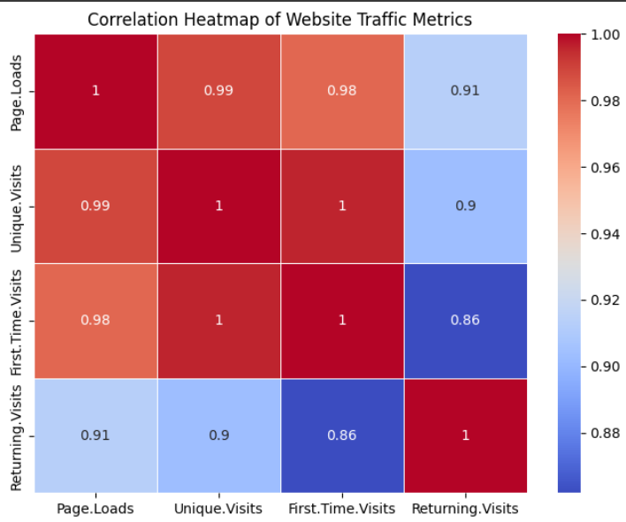
High Positive Correlation: Most metrics show strong positive correlations, meaning more unique visits lead to higher page loads and first-time visits contribute significantly.
Page Loads & Unique Visits: A strong correlation (0.99) indicates that unique visitors drive page loads.
First-Time & Unique Visits: A perfect correlation (1.00) suggests that most unique visits come from first-time visitors.
Returning Visits: Moderately correlated (~0.9 with Page Loads & Unique Visits, 0.86 with First-Time Visits), implying returning visitors generate fewer page loads per visit.

Slide 11
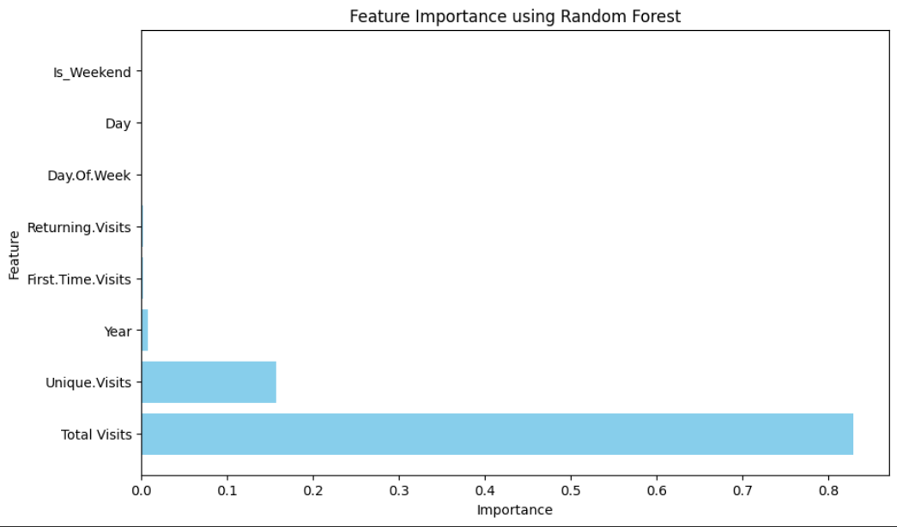
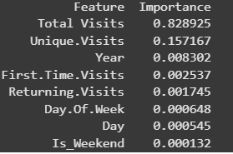
FEATURE IMPORTANCE
Total Visits is the most important feature, having the strongest influence on the model.
Unique Visits has moderate importance but is far less significant than Total Visits.
Other features (Year, First-Time Visits, Returning Visits, Day of Week, Day, IsWeekend) have negligible impact and are almost irrelevant to the model.

Slide 12
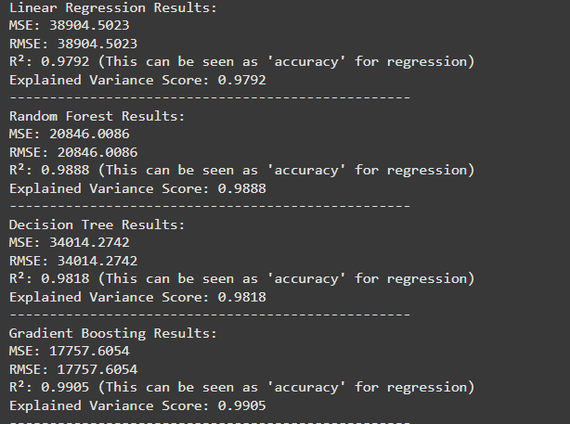
MODEL BUILDING
Gradient Boosting performed best with the lowest error (MSE: 17,757) and highest accuracy (R²: 0.9905), making it the most effective model.
Random Forest also performed well (R²: 0.9888) but had slightly higher errors than Gradient Boosting.
Decision Tree had moderate performance (R²: 0.9818) but higher MSE than Random Forest and Gradient Boosting.
Linear Regression had the weakest performance with the highest error (MSE: 38,904) and lowest R² (0.9792), indicating it struggles to capture complex patterns.

Slide 13
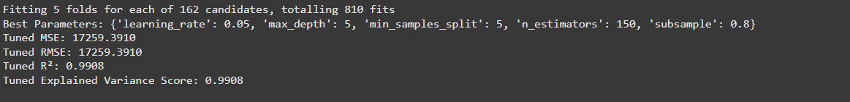
CONCLUSION
Why This Model Might Be Considered "Best" (Within This Tuning):
Excellent Fit: The R² and Explained Variance scores are very close to 1 (0.9908), indicating that the model explains a very high proportion of the variance in the target variable. In simpler terms, the model's predictions are very accurate on the data it was trained and tuned on
.
Low Error: The MSE and RMSE are relatively low, suggesting that the model's predictions have small errors. Again, this demonstrates high accuracy.
Robust Tuning Process: The use of cross-validation during the grid search helps ensure that the chosen hyperparameter generalize well to unseen data, reducing the risk of overfitting.

Slide 14


